Slide 1
EV MOTOR TEST BENCH Prepared by mayuri Kadam

Slide 2
INTRODUCTION
Motor Test Bench (also referred to as Stand) is designed for performance as well as endurance testing of Synchronous, Asynchronous AC Induction motor variants. In addition to the mechanical design, an electric motor test Bench consists of accompanying measurement devices, sensors and application software. The systems used to control and monitor the test objects are also included in the test bench
A typical test setup includes a load machine (Dynamometer), and torque flange. An externally applied load is used to strain, i.e., load, the motor. Using this method, simple characteristics can be directly mechanically acquired and the derived variables calculated. From the input current and input voltage, the absorbed power can also be recorded. Similarly, from the rpm and torque output values, the mechanical power output can be determined, and thus, the efficiency of the motor.
These Motors are tested for different Torque & Speed Test points, mainly Rated Torque as well as the Stall Torque. The Control System along with the AC Drive helps control the AC Dynamometer in Constant Torque or Constant Speed modes.
Advantages
• Testing of different types of motors can be realized • No change to the test algorithm necessary • After adapting, further tests are easily implemented • Simple design • Fast test methods
Disadvantages
• Mechanical modifications are necessary for each motor or shaft change • Systematic errors in the test sequence are possible if the tests are incorrectly parameterized • Time-consuming adapting of test objects to the test stand before testing can take place

Slide 3
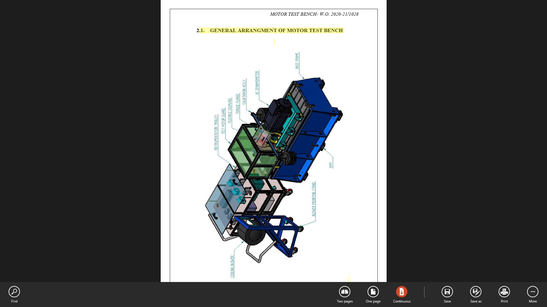
GENERAL ARRANGMENT OF MOTOR TEST BENCH

Slide 4
2.2. Drive Line :
It comprises of
Base Frame : 01 Nos.
AC Dyno. Mounting Stool : 01 Nos.
AC Dynamometer : 01 Nos.
Half Coupling For AC Dynamometer : 01 Nos.
Ringfeder: 01 Nos.
Adaptor Plate : 01 Nos.
Torque Flange : 01 Nos.
Flexible Coupling : 01 Nos.
Guard For Coupling : 01 Nos.
Test Motor Mounting Fixture : 01 Nos.
Half Coupling For Test Motor : 01 Nos.
Cooling blower assly. : 01 Nos.
Levelling Mounts / AVM : 06 Nos.
Test Motor Guard : 01 Nos.
Torque Measurement & Verification Kit : 01 Set.
Test Motor : 01 Nos.

Slide 5
Base Frame
It is MS fabricated frame of size 1600 Lg. x 700 W x 580 H. having following features. The fabricated structure is stress relived and designed to withstand the Dynamic shocks. Main attention need to be paid to stiffness and stability of the concrete base to ensure minimum deflection under applied loads.
➢ Strength, Durability & ease of installation. ➢ Provision of T-slots for ease of mounting. ➢ Provision of tenon for ease of alignment. ➢ Provision of grouting holes.
AC Dyno. Mounting Stool
The MS Fabricated Stool is used to mount the AC Dynamometer. The Stool would adapt to Common MS Fabricated Frame & Torque Flange to maintain workable centre height of approx. 900 mm from the ground level. The fabricated structure is stress relived and designed to withstand Dynamic shocks. The Stool will ensure Motor perfectly rests on four points.
AC Dynamometer
AC Induction Motor, which has compact dimensions. Square frame design and high overload capacity gives the motor an excellent dynamic response as compared to a conventional AC Induction Motor. The AC Dynamometer is connected to the EV Motor under test using suitable Flexible Disc Coupling. During the Absorb mode the Power Absorbed is dissipated using Dynamic Braking Resistor & does not be fed back to Mains Grid. During Overrun phase the AC Dynamometer acts as a motor & the AC Drive draws power from the AC mains. The overrun/drive mode is used to motor the test subject at different speeds.

Slide 6
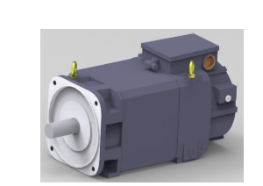
AC DYNAMOMETER
➢ Make : SIMENS ➢ Power : 28 kW @ 2000 rpm. ➢ Torque : 134 Nm ➢ Max Mechanical speed : 10000 rpm. ➢ Ventilation : Forced Cooled NDE to DE ➢ Mounting : Foot Mounting ➢ Speed Feedback : Inbuilt Incremental Encoder ➢ Temperature Protection : pt 1000 Temp. Sensor in Stator Winding

Slide 7
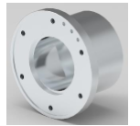
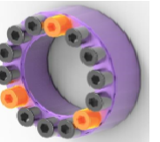
Half Coupling For AC Dynamometer
➢ Half coupling is used to connect AC dynamometer & Torque Flange by means of Adaptor plate. ➢ Coupling having locking provision which is essential during torque flange calibration (Mechanically).
Ringfeder
Description : RfN 7012 ➢ It is keyless shaft-hub locking device. ➢ It is used to connect half coupling & keyless shaft of AC dynamometer. ➢ Tightening torque : 41 Nm.

Slide 8
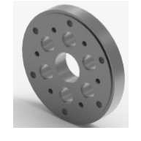
Adaptor Plate
It is En8 round plate used to connect half coupling with flexible coupling.

Slide 9
Torque Flange :
Used for measurement of driveline torque of the EV Motor under test. The Flange is mounted on the AC Dynamometer output shaft.
The sensor is Factory Calibrated by the OEM. Suitable OEM Test Certificate is provided along with the Equipment documentation. Alignment of the sensor should be as per OEM guidelines. SAJ recommends User to take special care & ensure alignment within the tolerance specified. Shunt Method is used for Torque Flange Health check.
To avail periodic Calibration service for the Torque sensor traceable to NABL, User shall send the sensor to the HBM recommended Calibration Labs only. Any Repairs required for the sensor due to offset/disturbance, User should send the sensor to the OEM directly. Regional offices of these OEM’s shall provide the necessary assistance.
Make: HBM
Model: T 40B
Accuracy Class : 0.05
Nominal Rated Torque : 200 Nm
Degree of Protection : IP 54

Slide 10
Flexible Coupling :
Flexible Disc Coupling is used for connection between the AC Dynamometer & EV Motor to be test. The specification of Coupling is as follows The proposed coupling shall suit continuous duty testing of EV Motors up to 135 NM Torque & 8000 RPM Max Speed.
Type : ESCODISC DPUFF 38.
Max Continuous Torque : 190 Nm.
Power : 36 Kw.
Speed : 10000 rpm.
Weight : 4.15 kg.
Inertia : 0.0076 kg-m2
Length / DBFF : 150 mm.

Slide 11
Guard For Coupling :
MS fabricated sheet steel guard is designed for safety against rotating assemblies during testing. ➢ Limit switch provision for safety interlocking with test bed automation system.
Test Motor Mounting Fixture :
MS fabricated fixture is specially designed for mounting of the different test motors. ➢ User need to change adaptor ring according to test motor variant. ➢ The fabricated fixture is stress relived and designed to withstand Dynamic shocks.
Half Coupling For Test Motor :
Dynamically balanced half coupling is used to connect Test motor & flexible coupling.
Cooling Blower Assly. : During load test or long duration test the EV motor body temperature increases, light duty cooling blower allows air flow on motor & take away some of this heat.
Make : Dynamic Motor , Type : Centrifugal , Model : DB24S4 , Air Flow : 2700 m³/hr.

Slide 12
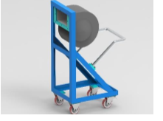
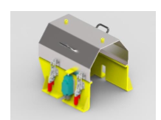

Slide 13
Levelling cum Anti Vibration Mounts :
The Base frame is mounted on Levelling cum Anti Vibration Mounts [Make: Polybond]. These mounts help level the frame as well as dampen low amplitude vibrations which may arise during testing. The mounts are resting free on customer built concrete floor, which is flat as per Industrial Floor norms.
Test Motor Guard :
Guard is provided to cover the EV Motor side of the test bench. The guarding ensures suitable protection of the surrounding working space while the EV Motor is under operation. We have considered transparent polycarbonate glass to view the test article while under test at the same allow air to get circulated within the enclosed space.
Torque Measurement Verification Kit :
Provided to carrying out periodic torque measurement verification for the Torque Flange.
It comprises of :
Calibration Arm & Counter Balance Arm with Rider Weight • Weight pan assembly
One set of Calibration Weights (to suit FS 135 NM, traceable to NPL)
Note: The Kit is only suitable for Torque measurement accuracy verification up to +/- 0.2 % of 135 NM. It helps test engineers for basic diagnostic. It is not meant for Calibration verification of Torque Flange as per Accuracy Class 0.05 which is done in calibration labs.

Slide 14
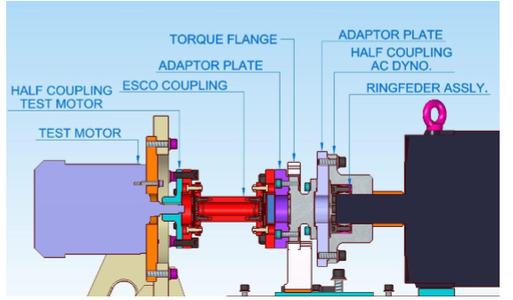
DRIVE LINE ALIGNMENT

Slide 15
For satisfactory operation of driveline, driving & driven shaft should be co-planar. User should follow the following procedure for alignment of driveline.
I. Place the half coupling & Ringfeder assembly on the shaft of AC Dynamometer.
II. Fasten the bolt of the Ringfeder assembly. (for specified torque value, please refer RfN catalogue)
III. Check the Run-out & Face-out values are within the permissible limit.
IV. Fix the adaptor plate on the half coupling & fasten the bolts.
V. Fix the torque flange on the adaptor plate & fasten the bolts. (for specified torque value, please refer Torque Flange catalogue)
VI. Fix the half coupling on the test motor shaft.
VII. Check the DBSE is as per coupling model

Slide 16
CALCULATION OF POWER
AC Dynamometer (Torque Flange) has calibrated/verification before dispatch from the factory and any necessary adjustments carried out during commissioning. Once the AC dynamometer has been calibrated the power developed by the Motor on test may be calculated using the following formula:
• Power (kW) = Torque (Nm) x Speed (Radians/sec) / 1000 ( in S.I. Units)
• Power (hp) = Torque (lbf. ft.) x Speed (Radians/sec)/ 550 (in Imperial Units)
2. The dynamometer (Torque Flange) is get calibrated in either Imperial or S.I. Units or MKS as specify by the customer at the time of ordering. The above formula can simplified as follows:
POWER = WN/K
Where,
N = Shaft speed in rev/min
W = Torque (indicated on torque indicator)
K = Constant dependant on units of power and torque

Slide 17
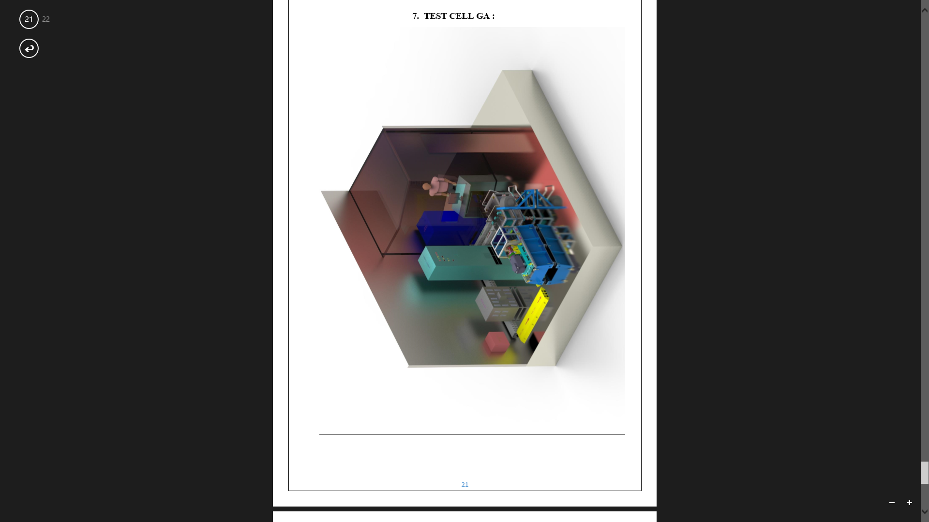
TEST CELL

